Slide 1

Learning support at Bilborough sixth form college

Slide 2
the TEAM;
what do we do?
Our small, friendly team is made up of specialist professionals offering support in relation to a wide range of additional needs including;
Specific learning needs like dyslexia
Physical health difficulties including visual and hearing impairments
mental health needs
neurodiverse needs such as asd or adhd
It is important to note that the team are providing support for students and are NOT in a position to diagnose.the only exception to this is dyslexia, please see the section later on how that can be supported at college.

Slide 3



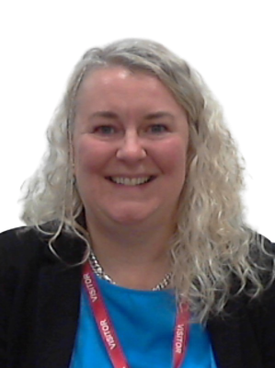
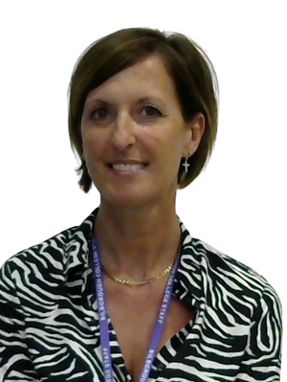
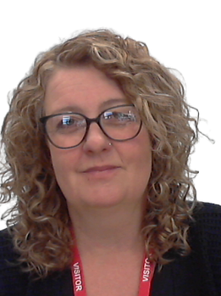
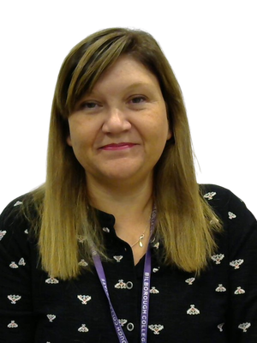
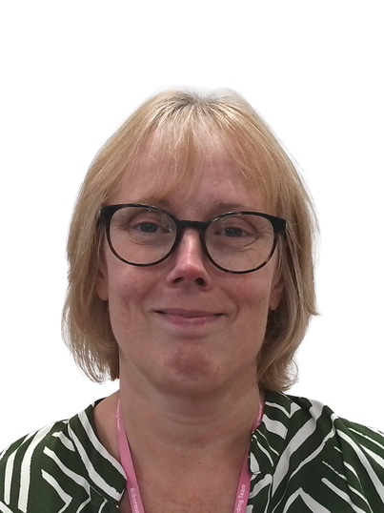
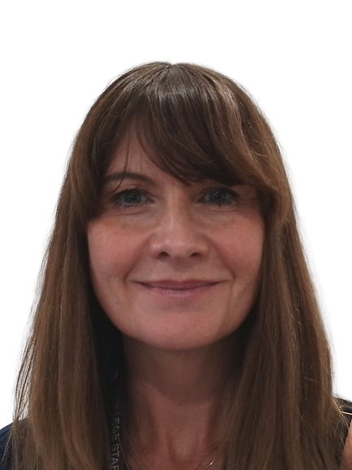
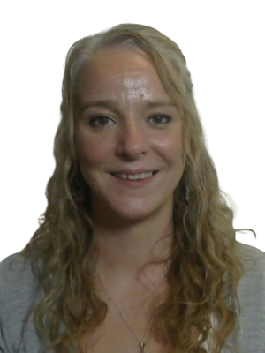
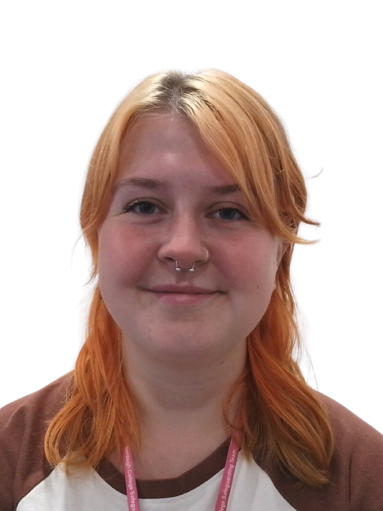
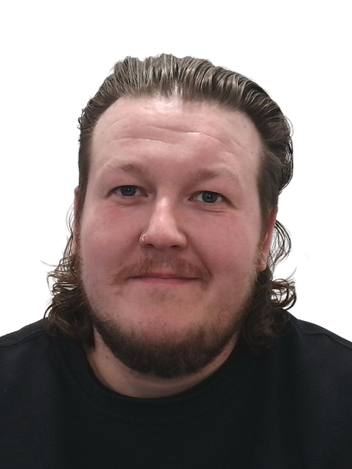
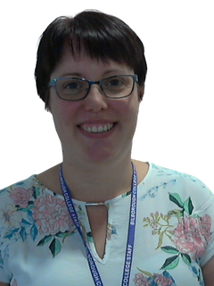
MEET THE TEAM
Kirsty - Learning support manager
Helen - specialist teacher
Emily- specialist teacher
Natalie - health coordinator
Kate- mental health coach
Gemma - neurodiversity specialist teacher
Angie - neurodiversity specialist teacher
Katie - neurodiversity specialist teacher
Mollie- neurodiversity mental health coach & referral coordinator
Josh - Mental health coach

Slide 4

EXAM ARRANGEMENTS
We can carry out the right assessments to see if you’re eligible for access arrangements in exams (such as extra time), or use clinical evidence you already have to apply on your behalf. As of 2025, teacher evidence will need to be collected in addition to this.
All applications are made in line with the current JCQ (Joint Council for Qualifications) rules.
It’s important to know that exam arrangements don’t automatically transfer from school to college — we have to apply for them again. Please ask your current school for copies of the evidence they used to secure any arrangements you had for your GCSEs, as this will really help us.
JCQ regulations are updated every year from 1st September, so it may not always be possible to apply for exactly the same arrangements as before — but we’ll always make sure we apply for the support you’re entitled to.

Slide 5


Liasing with teaching staff
At Bilborough, we don’t routinely have teaching assistants or learning support assistants in lessons. Because of this, clear communication with your teachers is really important. It helps them understand your needs and make reasonable adjustments within their teaching — so you can feel supported and able to succeed in class.
We will always talk to you about what is being shared and make sure you feel comfortable with the support in place.
After meeting with you, the Learning Support team can share helpful information with your teachers about the difficulties you experience and the strategies that work best for you in the classroom. This might include things like how you process information, support with organisation, managing anxiety, or strategies that help you focus and participate.

Slide 6
Additional support - dyslexia/dyslexic traits
You can access specialist 1:1 support in our Learning Support Hub — a dedicated study space for Learning Support and Wellbeing students. This gives you the chance to work with a specialist teacher to help with your studies.
If you’re already using the Hub but still finding things difficult, we can arrange more regular 1:1 sessions for more focused support.
We also offer full dyslexia diagnostic assessments at college, with some financial support available. Please ask us for current prices.
This is different from exam access arrangement assessments — there is no charge for those.

Slide 7

The neurodivergent team
The Neurodivergent Team at Bilborough College offers support to students who have, are in the process of getting, or are considering a diagnosis of a neurodivergent conditions including ADHD and/or ASD.
Our Neurodivergent Team Learning Support Teachers run academic support to help students find different ways of working that suit them best in a mainstream college environment.
Support is provided via our Learning Support Hub and additional 1:1 sessions where appropriate.
As part of the Neurodivergent Team we also offer wellbeing support with a Neurodivergent Mental
Health Coach and Specialist Referral Coordinator.
Here are some of the ways support is provided:
Support with transition into to college/post-18 pathways.
Support and advice with the first steps of getting a diagnosis including navigating the referral routes open to post-16 students and their families.
Tailored academic support including independent study strategies, time management and motivation, and revision and exam techniques.

Slide 8
medical and Physical health needs
We’ll meet with you to talk about the support you might need day to day. This could include things like lift passes, a Personal Emergency Evacuation Plan (PEEP), storing medication, or exam access arrangements.
With your agreement, we can also let your teachers know about any difficulties you experience and the best ways to support you in lessons.
If you have a visual or hearing impairment, we’ll discuss any specific support you need. We’re happy to work alongside any specialists already supporting you (and your family), such as BSL interpreters or assistive technology services, to make sure you have the right support in place at Bilborough.

Slide 9



key contacts
Learning.support@bilborough.ac.uk
To share exam access documentation from a previous school:
eaa@bilborough.ac.uk

