Slide 2
Course structure
Notes:
Brief overview, direct students to first page inside Taster session booklet for further breakdown of each Unit and assessment arrangements. Make point 50% controlled assessment and 50% examinations. They can also search Eduqas Criminology Level III of KS5 for spec. Units 1 & 2 = Cert. + Units 3 & 4 = Diploma. Session designed not to entice students but give them a very valid experience of what it is like to study Crim @ Bilborough.

Slide 3
Unit 2 – Criminological Theories
For our taster session we are going to concentrate on Unit 2, criminological theories.
We first need to acknowledge that there are many different theories that compete with each-other to explain crime in our society.
They are grouped into biological, individualistic (psychological), and sociological theories.
Today we are going to be introduced to one theory from each group and we are going to apply each theory to a scenario.
Notes:
Multi-disciplinary course, biology, psychology, sociology, law…

Slide 4
Notes:
We are going to apply different theories (biological, individualistic (psych) and sociological) to attempt to explain Jordan’s ealr criminal behaviour.

Slide 5
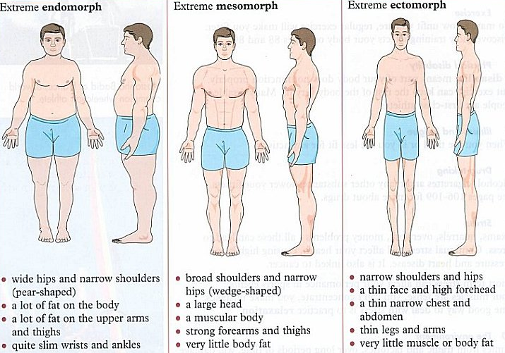
Notes:
Visual to accompany reading theory from the booklet

Slide 6
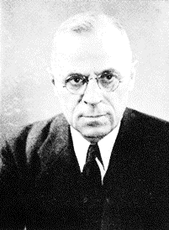
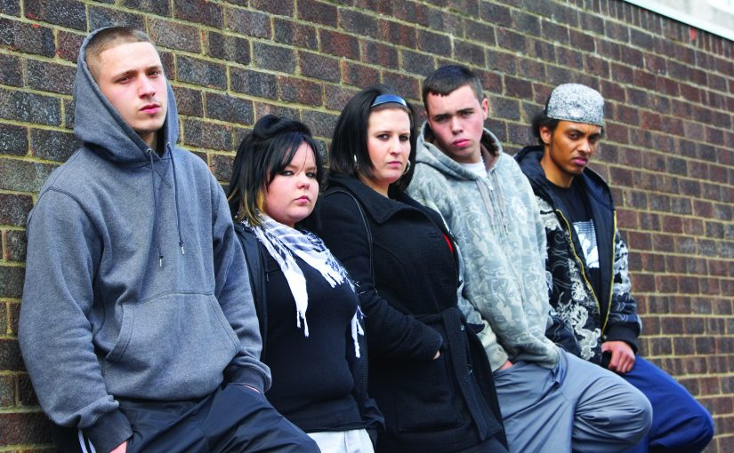
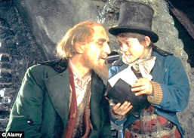
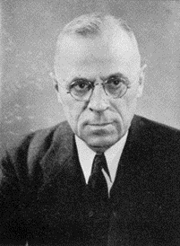
Notes:
Visual to accompany reading theory from the booklet

Slide 7
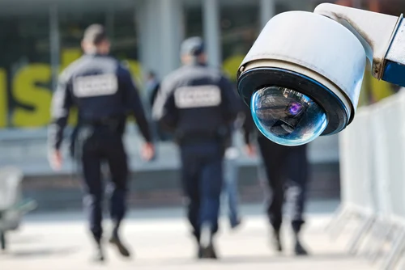
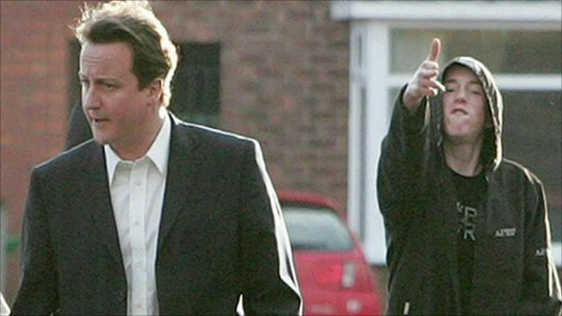
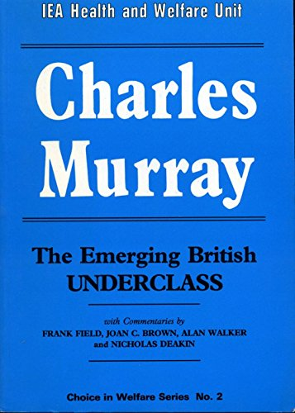
Notes:
Visual to accompany reading theory from the booklet

Slide 8
Which did you find the most convincing explanation for Jordan’s criminal behaviour at a young age?
Notes:
Don’t worry if you found them all flawed. There are lots of other!

Slide 9
The right realists argue that the solution to crime is to; reduce welfare dependency (families relying on benefits rather than going out to work), make it more difficult for criminals to commit crime, and make punishments more severe.
According to the right realists, these measures will all help to compel criminals to make the rational choice that crime ‘doesn’t pay’.
The right realists have been very influential in the United States with the Republican Party and in the United Kingdom with the Conservative Party. The Conservative Party has been in government in the UK since 2010 and prior to that from 1979 to 1997.
The influence of the right realists on successive Conservative governments has inevitably affected their policies in relation to crime and justice.
For your homework, you will explore the evidence for the influence of the right realists on Conservative government’s policies. Do an electronic search and summarise your findings below.
What have they done in the following areas of policy?
Welfare benefits
Making it more difficult to commit crime (situational crime prevention, target hardening)
Prison Sentencing Policy
Notes:
Not looking for cut and paste – rather a summary of evidence of the influence of the right realists on Conservative governments.

